Slide 1
Quantum Weirdness

Slide 3
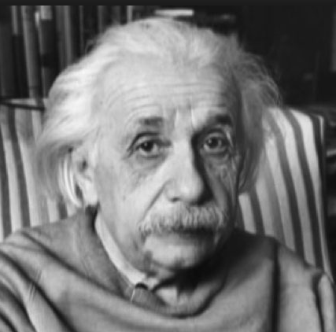
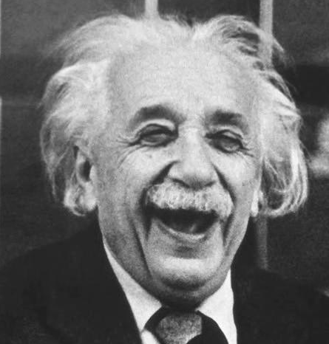
Einstein is NOT Happy!
QM is a great theory BUT it cannot be complete
Otherwise
QM undermines our very notion of reality itself

Slide 4
The Einstein-Podolsky-Rosen Paradox (EPR Effect)
A pair of electrons are emitted from a source – in order to conserve angular momentum they must have equal and opposite spins
Two detectors – far apart – are made ready to receive the electrons.
As soon as you measure the one electron’s spin you know the other with certainty and without measuring it!
What ever we do at A collapses the wavefunction for both quanton A as well as quanton B – essentially instantaneously! Einstein called this “spukhafte Fernwirkungen” or “spooky action-at-a-distance”

Slide 5
What Einstein thought…
QM is not yet complete – there are some “hidden variables” that if we knew would allow us to completely predict quantum behaviour
Electron spins are real properties that exist independent of any measurement process – the entangled electrons in the EPR effect must have additional information that nature uses
The world is:
1) objectively real
2) local (faster than light communication is impossible)

Slide 6
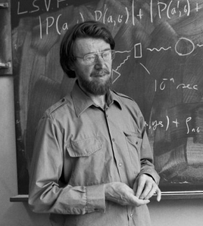
Bell’s Theorem
Physicists thought that the EPR effect was un-testable, just a metaphysical argument
In 1964 John Bell discovered a remarkable argument that shows that the EPR effect is testable!
Einstein’s belief in hidden variables & locality makes a very different prediction than does QM!

Slide 7
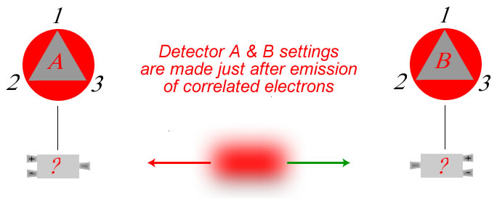
A delayed choice experiment
“Similar” to actual experiments conducted by John Clauser (1972), Alain Aspect (1981)
The “set-up”
There are 9 setting combinations
1 | 1
1 | 2
1 | 3
2 | 1
2 | 2
2 | 3
3 | 1
3 | 2
3 | 3
QM prediction: the detectors at A and B will be correlated (flash same color) 50% of the time, P = 0.5
Go to spreadsheet
program

Slide 8
Example calculations…
Imagine each detector is aligned in position 2
If an electron emerges from the + channel in detector A it must be in the state
The electron at B must be in the state so the probability that it will emerge from the bottom channel of B is:

Slide 9
Example calculations…
Imagine detector A is aligned in position 2 while B is in position 3
If an electron emerges from the + channel in detector A it must be in the state
The electron at B must be in the state so the probability that it will emerge from the bottom channel of B is:

Slide 10
So… QM predicts
Correlation occurs half-the-time:
(3/9)1 + (6/9)(1/4) = 1/2

Slide 11
What does “Classical Physics” predict?
Each pair of electrons must have additional (possibly unknown) objectively real properties that explain why the detectors are correlated
They would produce an equivalent effect to the following:
There are 8 possible “kinds” of electrons or sets of properties like this:
flash red if detector is in position 1, green if in position2, red if in position 3, etc….
RRR RGR RGG GRG GRR GGG RRG GGR

Slide 12
Summary of Classical Version
 | 11 | 12 | 13 | 21 | 22 | 23 | 31 | 32 | 33 | Pr(s)
RRR | S | S | S | S | S | S | S | S | S | 1
RRG | S | S | D | S | S | D | D | D | S | 5/9
RGR | S | D | S | D | S | D | S | D | S | 5/9
RGG | S | D | D | D | S | S | D | S | S | 5/9
GRR | S | D | D | D | S | S | D | S | S | 5/9
GRG | S | D | S | D | S | D | S | D | S | 5/9
GGR | S | S | D | S | S | D | D | D | S | 5/9
GGG | S | S | S | S | S | S | S | S | S | 1
Classical Physics predicts that correlation should occur at least 5/9 of the time

Slide 13
Quantum Mechanics!

Slide 14
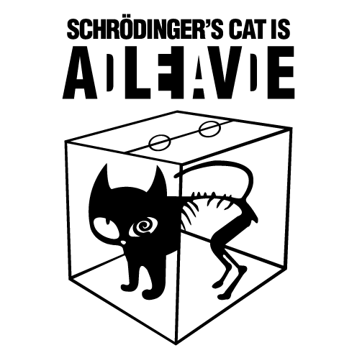
And then there’s Schroedinger’s Cat!

